Slide 1
Software Quality Challenges & Importance
By: Engr. Dr. Sumaira Nazir
Assistant Professor
Department of Software Engineering
National University of Modern Languages Islamabad

Slide 2
Quality Challenges

Slide 3
The Quality Challenges
Software Quality Measures differ from
Project to Project
Organization to Organization
User to User
Small Systems to Large Systems
Real-time Applications to Non Real-time Applications

Slide 4
The Quality Challenges Cont.
Evaluation takes place at each step of SDLC
Quality criteria vary dramatically depending on the phases of the project at which the evaluation takes place.
Must be planned from the beginning
Quality must be planned into the project structure, constantly evaluated, and corrections applied when deficiencies are identified.

Slide 5
The Quality Challenges Cont…
Quality goals must be clearly defined, effectively monitored, and rigorously enforced.
Ensure consistency of quality criteria with defined requirements.
Throughout software development, the management of the quality must be an overriding concern of all project personnel.

Slide 6
Why is Quality Important?

Slide 7
Why is Quality Important?
Competitive Issue
Survival and Success
Global Reach
Cost Effective
Retain Customers and Increase Profits
Increase Return on Investment(ROI)

Slide 8
Competitive Issue
Cannot rely on software functionality alone (numerous similar software exists).
Quality differentiate your product from your competitors + Quality of support.
Software market matures, customers want to be assured of quality.
Customers prefer Quality Standards Certified organizations.
Quality certification is considered when outsourcing work.

Slide 9
Survival and Success
Difficult to survive if customers are not satisfied with the quality.
Organizations will not succeed in this global market unless they produce quality products/services.
Large organizations are deciding to reduce no. of suppliers & focus on quality improvement.

Slide 10
Global Reach
Maintaining Quality standard gives an edge to enter the international market.
Small companies can have big clients (Microsoft, Google, Ericsson, etc) by having Quality Certification.
Company having fewer employees can have projects from big companies by maintaining their Quality.

Slide 11
Cost Effective
Fixing bugs/defects are costly.
Cost of correction earlier < late in the development life cycle.
Cost of low-quality products > 50% of total costs in the Software company.
Redirecting resources towards prevention decrease cost.
Initial cost for establishing a quality system is greater but it reduces later.

Slide 12
Retain Customers and Increase Profits
Customers demands quality.
Poor quality costs customers more than the supplier.
Most customers don’t tolerate bad quality and place their business somewhere else.
Better quality leads to improved customer satisfaction.
Retaining Customers
Cost of getting new customers is much higher.
5% increase in customer retention increased profit by 35%.

Slide 13
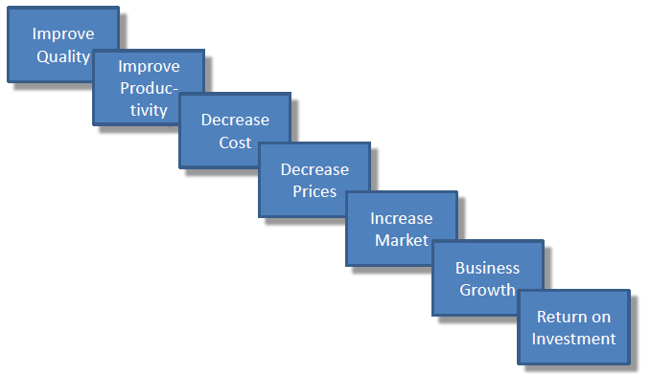
Software Quality and ROI

Slide 14
Changing View of Quality

Slide 15
Changing View of Quality
PAST
Quality is the responsibility of blue-collar workers and direct labor employees working on the product.
Quality defects should be hidden from the customer and management.
Quality problems lead to blaming, faulty justification, and excuses.
PRESENT
Quality is everyone’s responsibility, including white-collar workers, the indirect labor force. and the overhead staff.
Defects should be highlighted and brought to the surface for corrective action.
Quality problems lead to co-operative solutions.

Slide 16
Changing View of Quality Cont.
PAST
Corrections-to-quality problems should be accompanied with minimum documentation.
Increased quality will increase project costs.
Quality is internally focused.
Quality will not occur without the close supervision of people.
Quality occurs during project execution.
PRESENT
Documentation is essential for “lessons learned” so that mistakes are not repeated.
Improved quality saves money and increases business.
Quality is customer-focused.
People want to produce quality products.
Quality occurs at project initiation and must be planned for within the project.

Slide 17
Assignment # 1
Explain the relationship between the improved quality and ROI based on Deming’s chain reaction with the help of any case study.

